Slide 1
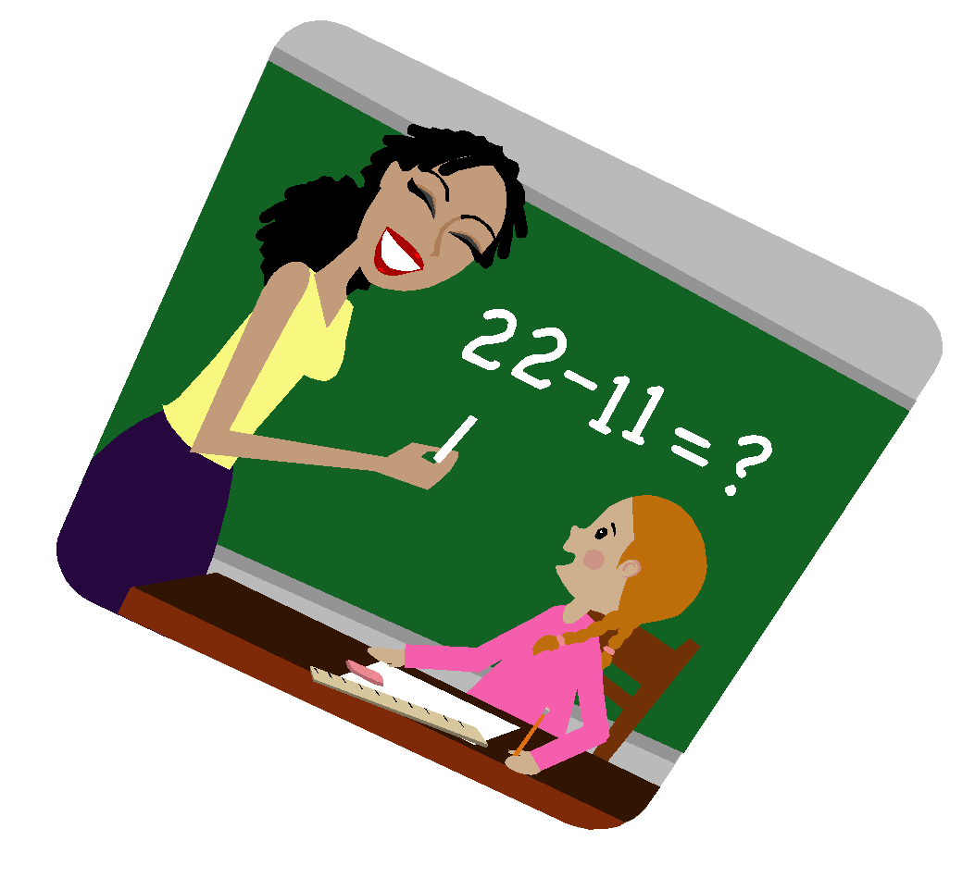
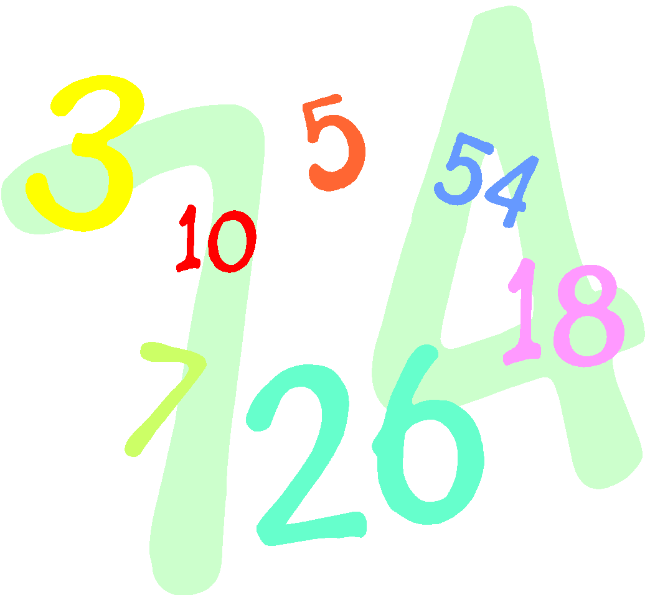
Welcome to 7th Grade Math Room 118
2019-2020
Ms. Elizabeth Garcia
Notes:
1

Slide 2
Expectations
Be respectful.
Be responsible.
Be prepared.
Be on time.
Notes:
2

Slide 3
Rules
Use appropriate language
Follow directions
Stay on task
Bring all materials
Raise your hand when asked
Notes:
3

Slide 4
Positives
Verbal praise
Positive recognition
Positive phone call
Homework passes
Attendance party
Notes:
4

Slide 5
Level 1 Consequences
Warning
Student Conference
Parent Contact/Conference
Counselor Referral
Office Referral
Notes:
5

Slide 6
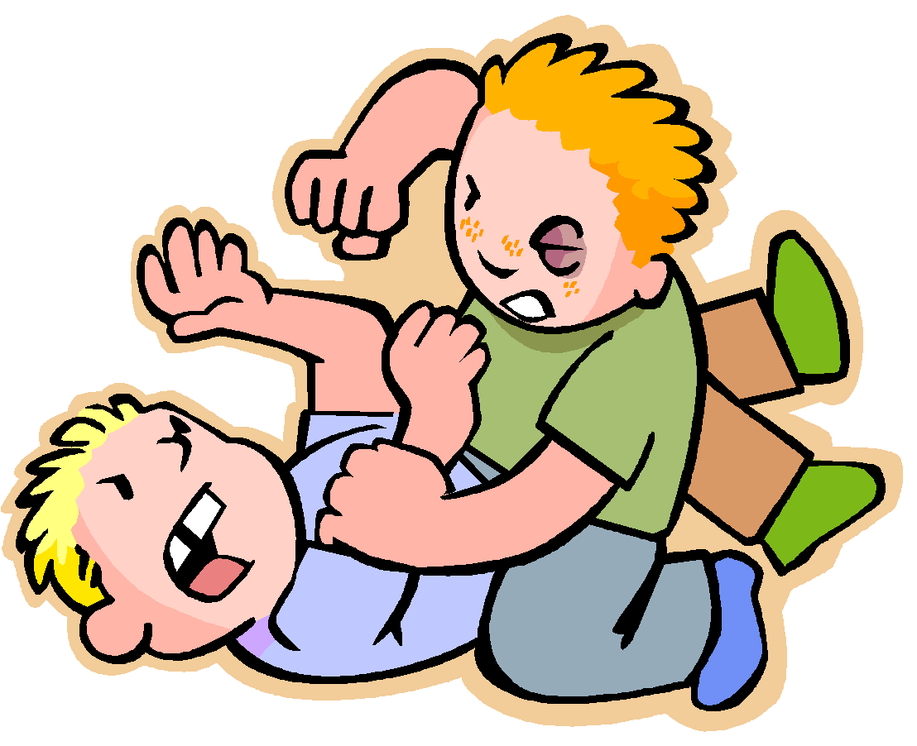
Automatic Referral
*Fighting *Stopping class from
*Vandalism functioning
*Truancy/Skipping *Fire Alarm/Graffiti
*Vulgar language *Overt defiance and
*Weapons disrespect
Notes:
6

Slide 7
MATH GRADING POLICY:
Minor Grade (Assignment/Activity): 40%
Major Grade (Test/Project): 60%
Notes:
7

Slide 8
Math Supplies
5 subject spiral
1.5” binder/ 5 tabs
Glue Bottle
Scissors
Pencils & Erasers
4 Dry Erase Markers
Highlighters/Crayons/Markers
Lined Paper
Ear buds
Notes:
8

Slide 9
Procedures
Bring your materials to class every day & be prepared.
Upon entering the classroom, sharpen your pencils.
At the beginning of class, you will work on Warm-ups for about 10 minutes. After reviewing the warm-ups, we will review any paper assignment given the previous day. Then, we will work on the day’s activity and/or lesson.
When working in groups, every student is responsible for working on the activity. Help each other and learn from each other.
Notes:
9

Slide 10
You are expected to complete all assignments. Parents will be notified if assignments are not completed.
If you need extra help, it is your responsibility to attend tutoring.
You will have online assignments from the GO Math Book as well as through Google Classroom.
I tutor Mondays, Tuesdays, and Wednesdays after school.
I will dismiss you not the bell.
If I allow you to leave the room, you must scan a QR code out and in.

Slide 11
Other Topics
We will walk past the bus pick up area during a fire drill.
During a lock down or shelter in place drill, no students are allowed to leave. We will be locked in the classroom.
Seating arrangements and roles change every 6 weeks.
Sages change every 3 weeks.
Please clean up after yourselves. I will dismiss the class once the room is in order.

Slide 12
Resposibilities
Materials: Bring your materials to class every day.
Behavior: Be on your best behavior daily. Respect. Follow dress code.
Attitude: Have a positive attitude. Being positive helps you succeed.
Tardies: If tardy, bring a tardy form.
Attendance: Be present every day. You’re responsible for work.
Hall Passes: Only allowed out in case of an emergency.
Grades: Keep up with your grades on Skyward.
Assignment Log: Keep track of assignments and due dates on the log.
Agenda: Write the objective for the day in your agenda.
Notes:
12

Slide 13
Binder Organization
Warm-ups: Work the problems on the sheet for 10 minutes. We’ll grade them before moving on.
Lessons: Book pages.
Assignments: Keep up with assignment logs on a daily basis.
Tests: Keep graded papers.
Vocabulary: Keep your glossary.
WRITE YOUR NAME AND DATE ON ALL PAPERS!!!!!
Notes:
13

Slide 14
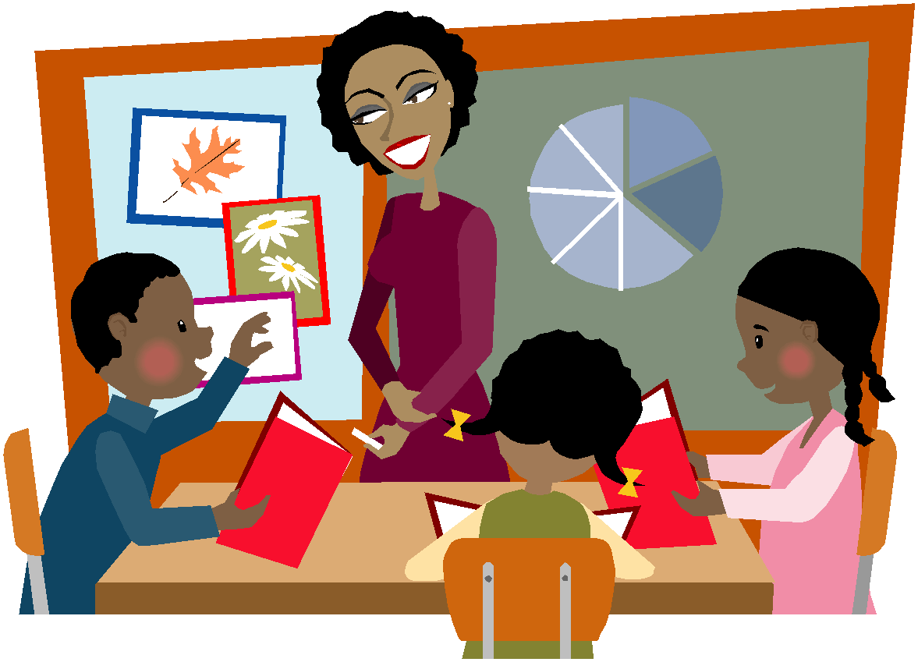
Let it begin with me!
I welcome you to a new school year. Be prepared to learn many mathematical concepts in 7th grade. Do your very best every day. Make the choice to learn!
HAVE A GROWTH MINDSET! THINK MATH!!
20 Things to Say
Notes:
14

